Slide 1

Leveraging Machine Learning for Risk-Rating Prediction
Hank Shao

Slide 2
Abstract
Target
Predicting the risk-rating with 128 continue variables and 4 categorical variables. Assessing the risk by multiple features for a new client.
Technique: machine learning
In model engineering, the following steps were chosen: Outlier removal, Missing data imputation using regression, Correlation and irrelevant feature elimination, One-hot encoding, standard scaling.
Fitting and tuning with random forest, XGBoost and Neural network. Overall 23% accuracy rate for mult-class classification, BR code 12 and Variable_17_Y0 have higher effect.
Business Benefits
The company can use these models to figure out if new clients are risky. This helps reduce losses with risky clients or invest more in safe clients to make more profit

Slide 3
Overview
Introduction and Description
Exploratory Data Analysis (EDA)
Model Engineering
Model Fitting
Extend: Deep Learning
Conclusion

Slide 4


1. Introduction and Description
Dataset
Purpose
Given a dataset of client risk rating and self exclude flag (determined by risk rating) as dependent variables, and 121 independent variables
Predicting risk rating to new clients, to identify high risk or safe clients for higher profits
Methodology
Software
Employed machine learning and deep learning for prediction
Python on Jupyter notebook, Tableau

Slide 5
Overview
Introduction and Description
Exploratory Data Analysis (EDA)
Model Engineering
Model Fitting
Extend: Deep Learning
Conclusion

Slide 6
2.Exploratory Data Analysis (EDA)
Variables overview
Categorical variables
Continue variables
Dependent variables
From Variable_1 to Variable_30
Country code: 0, 1, 2
Risk-rating:
Discrete data, from 1 to 17, 16 is missing
BR code: From 0 to 107
Each variable with Y0 (current year) to Y3 ( 3 years ago)
Self exclude flag:
0 if risk-rating > 8 , otherwise 1
Periods: From 2014 quarter 4 to 2020 quarter 1
Variable_18 and Variable_29 is missing Y3
Client ID: integers, not informative

Slide 7
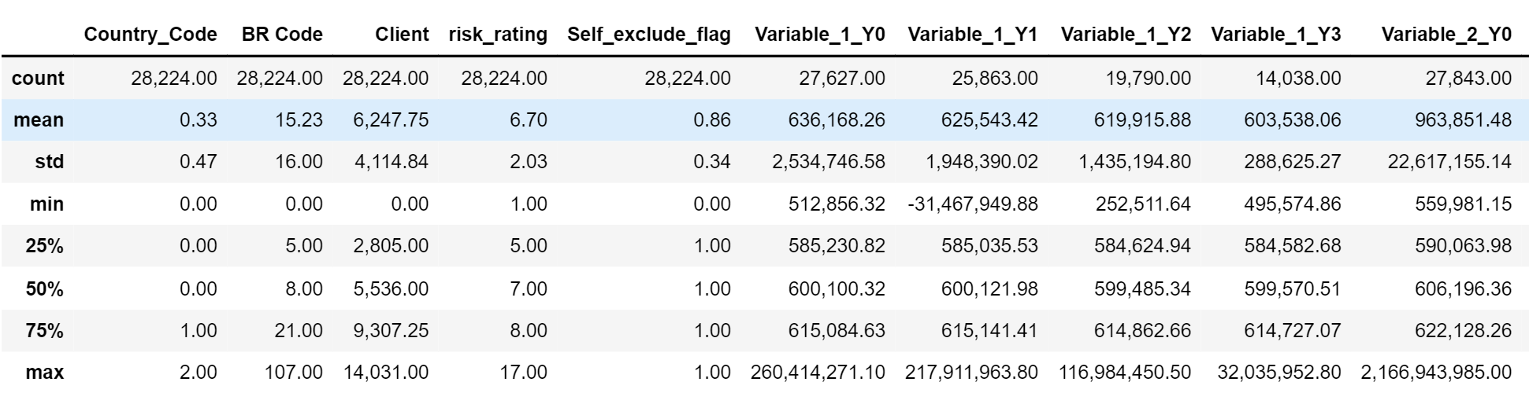
2.Exploratory Data Analysis (EDA)
Data description
The dataset has 28224 samples and the average rating is 6.7. The number of sample under each variables are less than total number of sample, which exists missing data

Slide 8
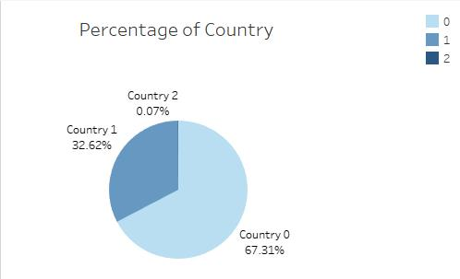
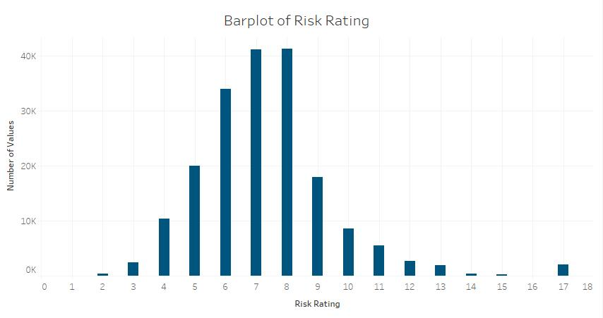
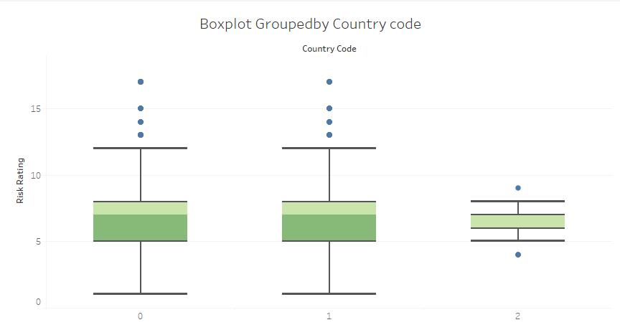
2.Exploratory Data Analysis (EDA)
Risk-rating and Country code
The graphs illustrate that the distribution of risk-rating and the clients’ locating.

Slide 9
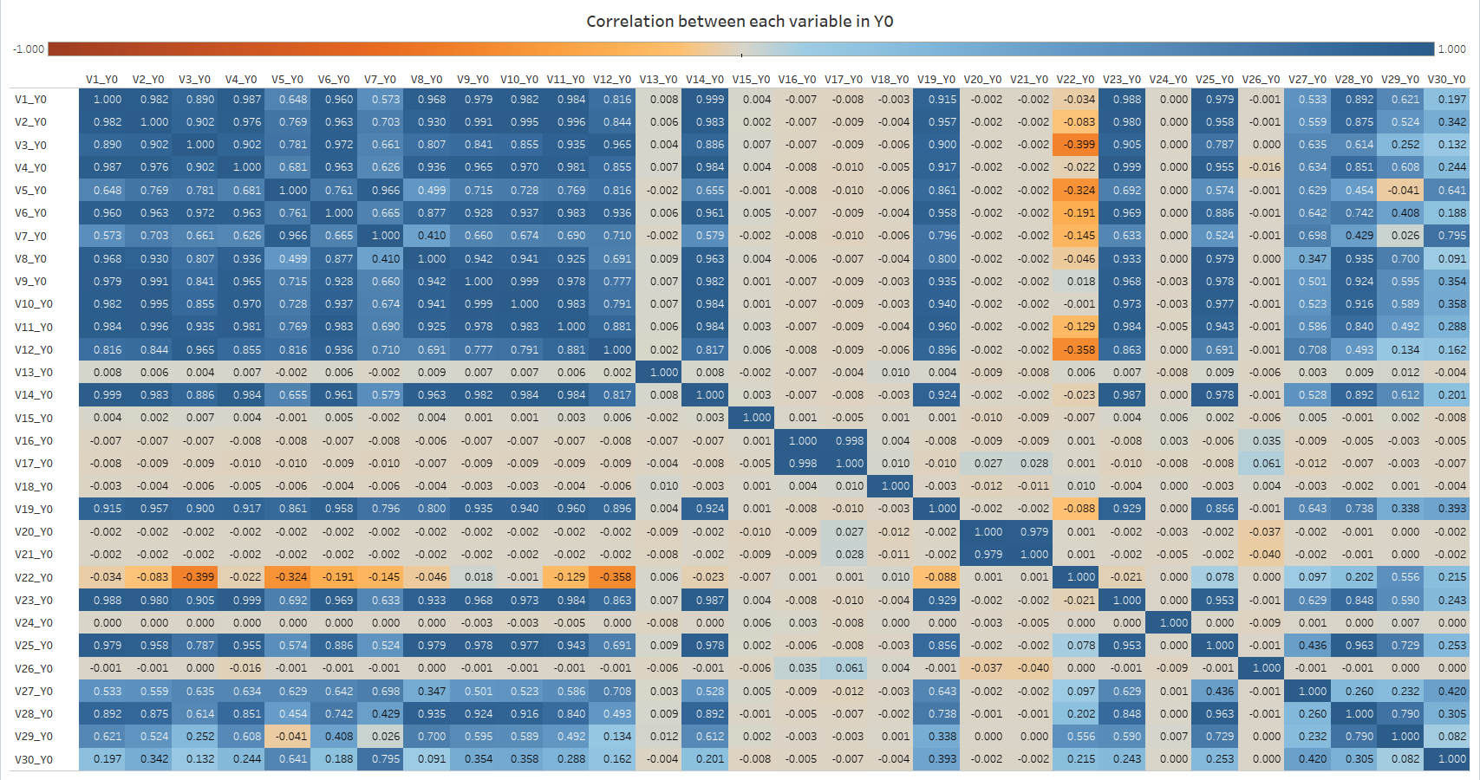
2.Exploratory Data Analysis (EDA)
Data visualization:
The correlation between all independent variables in Y0. V1_Y0 = Variable_1_Y0
This graph show that features have high correlation from V1 to V12, ,V19,V23,25, and V28

Slide 10
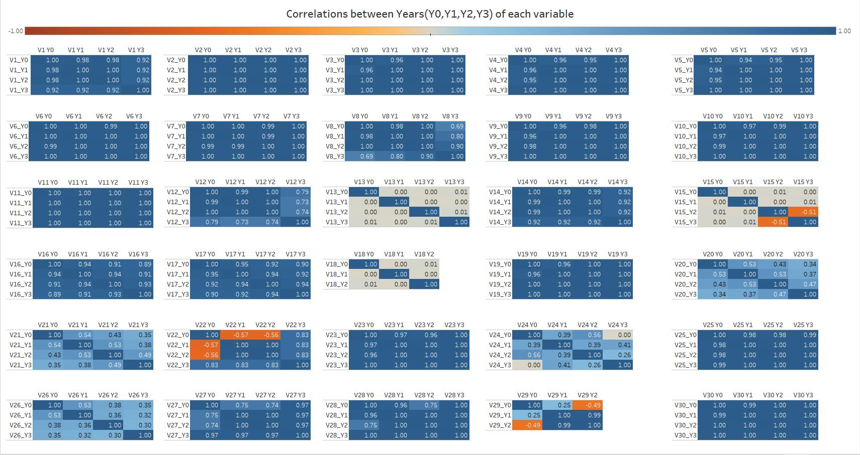
2.Exploratory Data Analysis (EDA)
Data visualization: The correlation between each independent variables in Y0, Y1, Y2, Y3. V1_Y1 = Variable_1_Y1
This graph show that most of features have high correlation in years (dark blue)

Slide 11
Overview
Introduction and Description
Exploratory Data Analysis (EDA)
Model Engineering
Model Fitting
Extend: Deep Learning
Conclusion

Slide 12
3. Model Engineering
Feature selection -- Remove the error data and extreme outliers
1. This step is done before missing data fitting, which avoid the bias
2. Calculating the mean and standard deviation for each column
3. Created a range of 2 standard deviation from mean
4. Dropping the row data without the range
5. Removed the all missing row data

Slide 13
3. Model Engineering
Missing data handling
01
Drop columns with more than 20% missing data
Imputation with mean
02
03
Imputation with median
04
Imputation using regression
Four methods are fitting in independent dataset and evaluation by decision tree

Slide 14
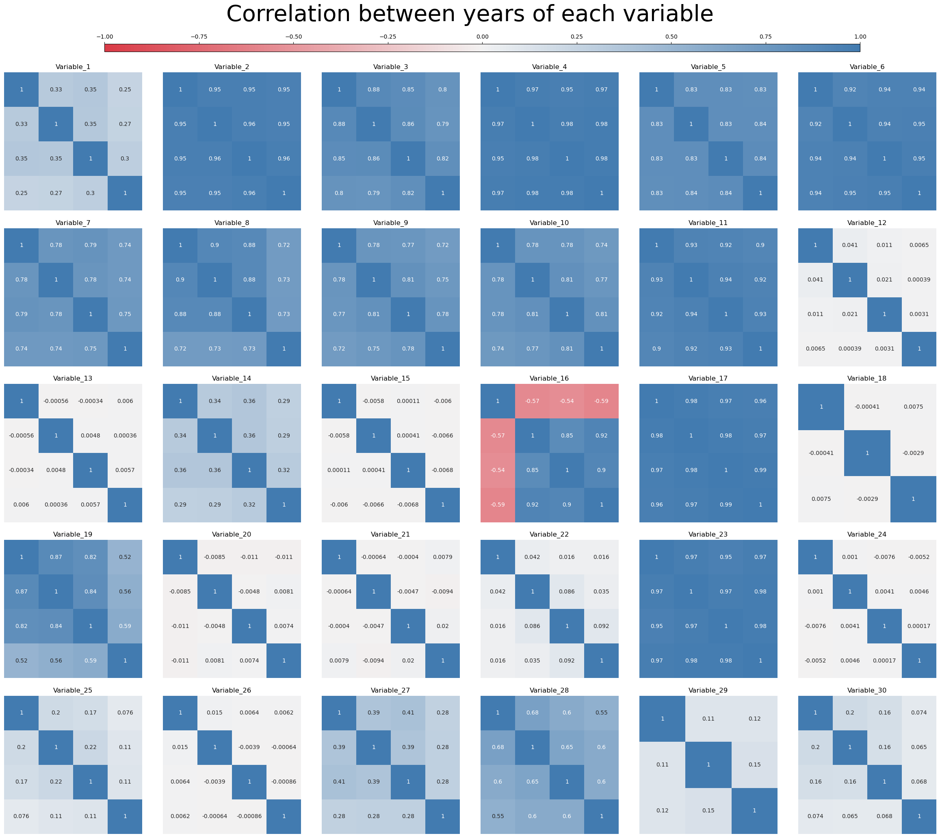
3. Model Engineering
Feature selection -- Drop columns with high correlation between features (method 4)
1. The final choice is Method 4
2. According to the graphs from description and above, Variables have high correlation in 2 to 11, 16, 17, 19 ,23 and 28.
3. Those variables will be dropped for better performance

Slide 15
3. Model Engineering
Feature selection -- ANOVA correlation coefficient and Kendall’s rank coefficient
ANOVA correlation coefficient:
It used to test the correlation between independent variables and target variables
Imported f_classif package from Sklearn
The strategy is calculating the F-value and compared with significant level
The significant level is 0.05
Kendall’s rank coefficient:
It used to test the correlation with input and output variables as well.
Imported kendalltau from scipy
Non-parametric test
The significant level is 0.05

Slide 16
3. Model Engineering
Standard scaled
Continue variables will be rescaled by mean = 0 and variances = 1
One-hot encoding categorical variables
All the categorical variable with n values will encode as n-1 binary variables, and the dropped variables is the standard and avoid correlation.
Country code will be encode to Country_0, Country_1, and Country_2. Country_2 will be dropped.
BR code will be encoded from BR_code_0 to BR_code_84 (some data was dropped). BR_code_0 will be dropped
Periods will be encoded by years. 2020Q4 will be dropped.
Label encoding target variable
Target variable will be encode to start from 0 to require the condition of XGBoost.
Target variable will be encode as binary variables for deep learning.

Slide 17
Evaluation of missing data methods
Employed Train-validation-test split approach
The evaluation of missing data fitting methods is F1 score in decision tree after above model engineering
Method 4 has the best performance
16.96%
Method 1
(drop 20% missing data)
16.44%
Method 2
(mean)
17.23%
Method 3
(median)
18.09%
Method 4
(regression)

Slide 18
3. Model Engineering
Summary
Removed row data with all missing value
Dropped data without the range of 2 standard deviation from mean of each column as extreme outliner
Fitting the missing data by regression imputation (method 4)
Dropped the high correlation columns
Dropped insignificant columns with outcome by ANOVA and Kendall’s rank
Standard scaled the continue variables
One hot encoding to three categorical variables
Encoded the target variable for XGBoost and Deep learning
Train-validation-test split

Slide 19
Overview
Introduction and Description
Exploratory Data Analysis (EDA)
Model Engineering
Model Fitting
Extend: Deep Learning
Conclusion

Slide 20
4. Model Fitting
Mult-class classification methods:
One Vs Rest (OVR)
One Vs One (OVO)
Both methods will be apply to the machine learning classifier for higher accuracy
Machine learning methods
If F1 scores is higher than 20%, those methods will test hyperparameter to achieve better performance
Naïve Bayes
KNN
Random forest
XGBoost
Base: 1.14%
OVO: 1.14%
OVR: 1.43%
Base: 17.01%
OVO: 19.29%
OVR: 16.49%
Base: 22.31%
OVO: 21.76%
OVR: 21.54%
Base: 20.88%
OVO: 21.49%
OVR: 22.08%
Therefore, Random forest and XGBoost will be moved to further tune

Slide 21
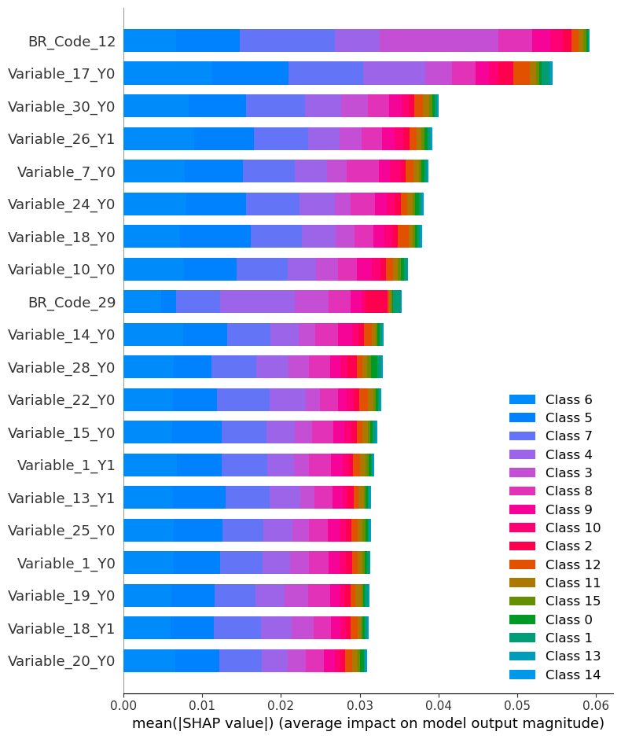
4. Model Fitting
Random Forest
The list of adjustment of hyperparameters:
Bootstrap, max depth, min samples split, max leaf nodes, min samples leaf, n estimators, max features, and criterion.
BR code 12 and Variable_17_Y0 have higher effect to the rating
Evaluated with F1 score in test set:
Baseline: 23.54%
One vs One: 22.01%
One Vs Rest: 22.36%

Slide 22
4. Model Fitting
XGBoost
The list of adjustment of hyperparameters:
max depth, gamma, and reg alpha
Evaluated with F1 score in test set:
Baseline: 21.65%
One vs One: 20.78%
One Vs Rest: 22.72%

Slide 23
Overview
Introduction and Description
Exploratory Data Analysis (EDA)
Model Engineering
Model Fitting
Extend: Deep Learning
Conclusion

Slide 24
5. Extend: Deep Learning
Neural Network
The list of adjustment of hyperparameters:
Number of hidden layers, hidden layer sizes, batch sizes, max epochs, and layer activation functions.
Loss function: Categorical Crossentropy
Optimizer: adam
Evaluated with accuracy in test set:
Best performance : 22.03%

Slide 25
Overview
Introduction and Description
Exploratory Data Analysis (EDA)
Model Engineering
Model Fitting
Extend: Deep Learning
Conclusion

Slide 26
6. Conclusion
Machine learning and Deep learning models are predict risk rating for client under mult-class classification
The dataset was preprocessed by:
Missing data fitting, dropping error and outliner
Feature selection, Standard scaled, encoding and Train-validation-test split
Random Forest, Neural network, and XGBoost are fitted and fine tuned
Random Forest and XGBoost are slightly better than Neural network.
Models’ F1 score and accuracy rate are around 23%

Slide 27
Thank you
The End

